Slide 1
Online Learning System for Python Scrapper
– Team 6 –
김상민, 김제현, 김호연, 박휘찬, 신동휘, 이지섭,

Slide 2
Contents
Backend
Frontend
IDE
Deployment

Slide 3
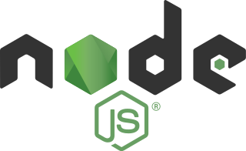
Backend – Node.js
Server configured with express module
Communicates with MySQL DBMS using sequelize module

Slide 4

Backend – MySQL
Database table structure
User
id (PK): bigint, email: string, password: string
Tutorial
id (PK): bigint, chapter: string, title: string, content: string
Problem
id (PK): bigint, chapter: string, problem: string, answer: string
UserProblemSet
id (PK): bigint, user (user.id), problem (problem.id), is_solved: enum [“Y”, “N”]

Slide 5
How to communicate Front & Backend
React
Web Cilent
Backend nodejs express provide api router with DB manager
Frontend can request GET or POST method with that url like /api/auth/login
If request income, backend response with some data to frontend client
This makes development pallely
Request
Response
Nodejs
sequelize
data
Mysql

Slide 6
IDE
React
CodeMirror
CodeMirror-based Python IDE
Python:3.10 Docker container
User-submitted codes run on this
If user click run or submit button, code and input will send to server
/api/runcode will execute a code
Result returned and shown in web page
Request
Response
Nodejs
Code, input
Output
Python3
Container
(volatility)

Slide 7
IDE
(modified) Using nodejs Python-shell for code executing ➔ secure issue, server attack, access to other user’s code… ➔ Virtualizing with Docker container
(added) Timeout 10 sec, Long output denied
(fixed) Post request to server with code
(fixed) Code-Mirror IDE design
(fixed) run with input, grading correct answers
(fixed) Code save and load for user

Slide 8


Frontend
Based on Next.js and React
Provides web page component structures
Such as log-in page and problem pages
Communicates with backend to fetch contents with API

Slide 9
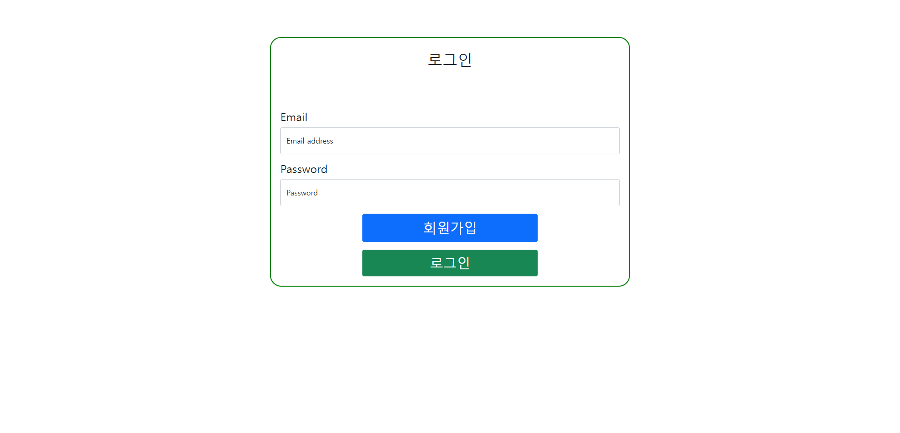

Slide 10
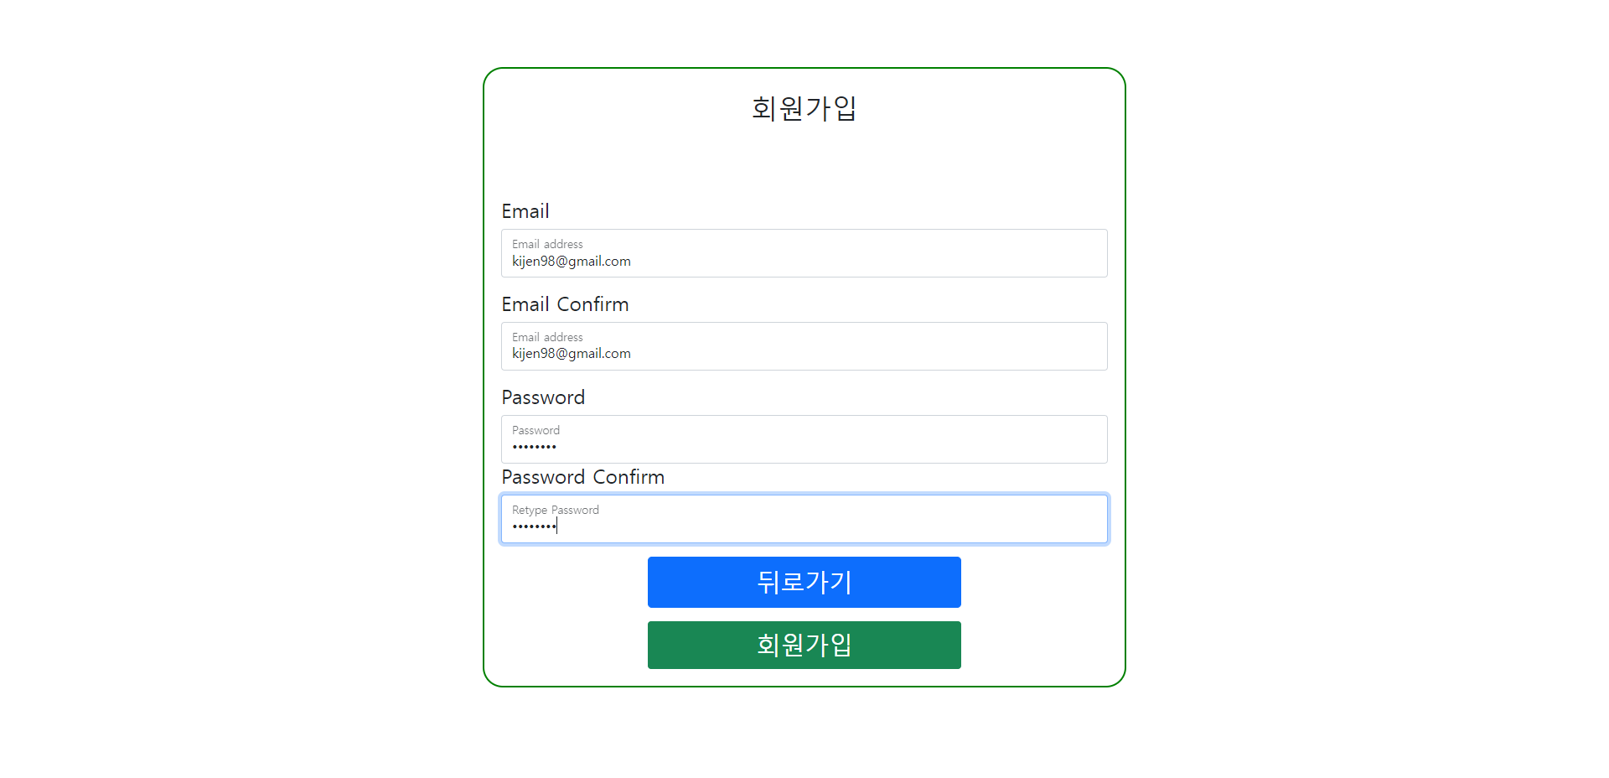

Slide 11
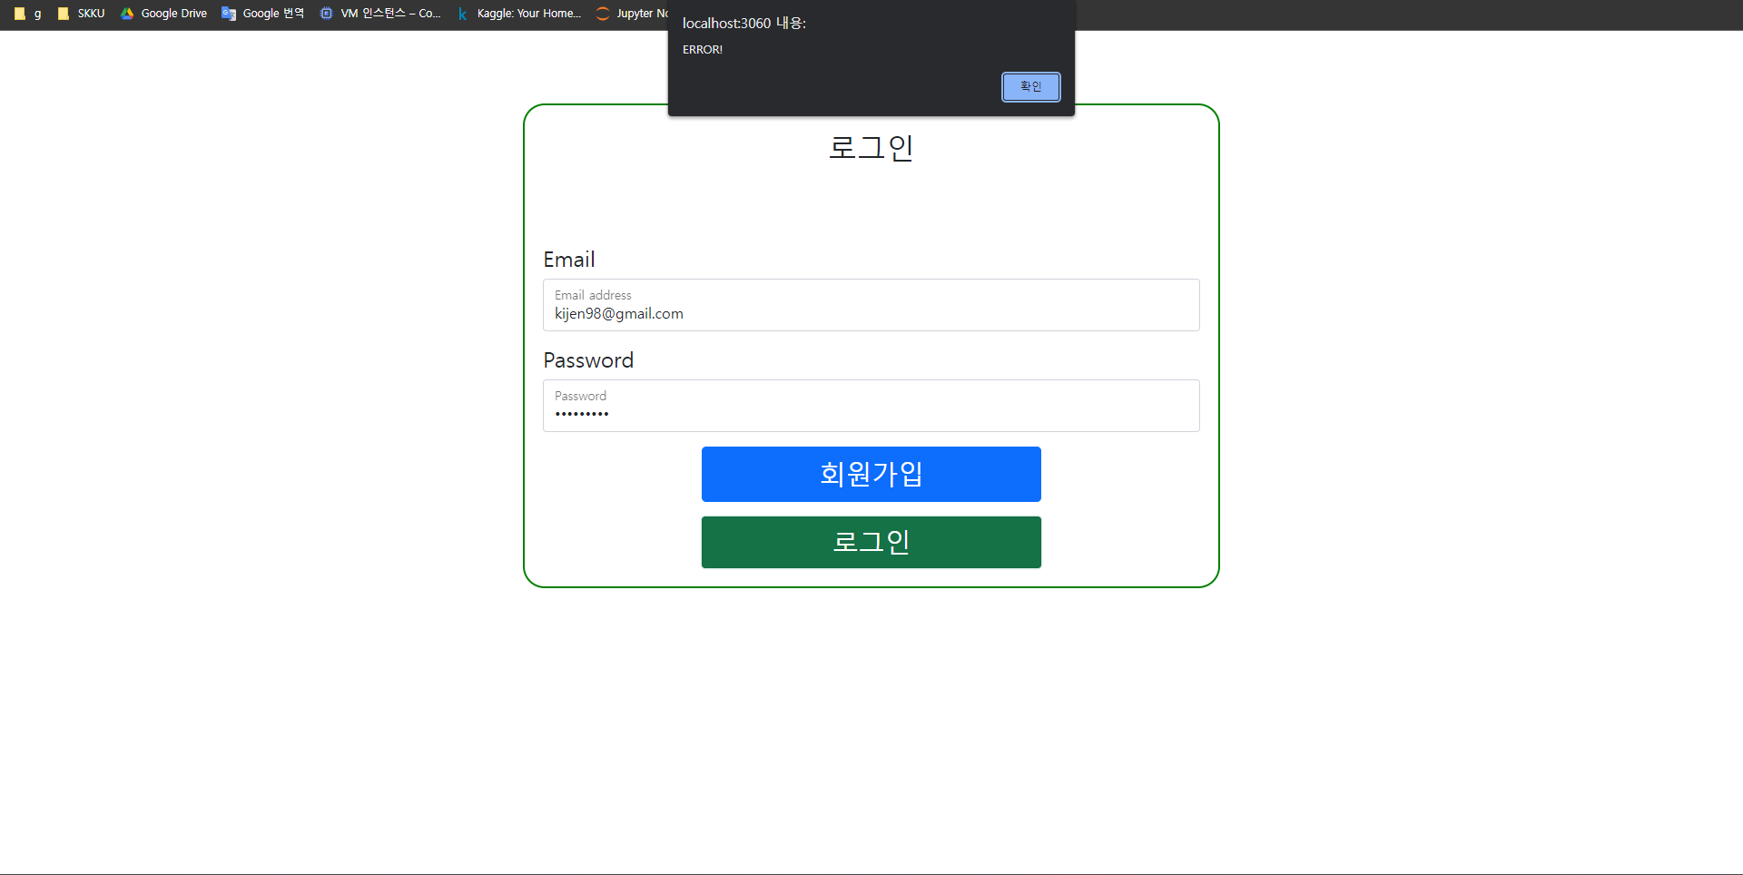

Slide 12
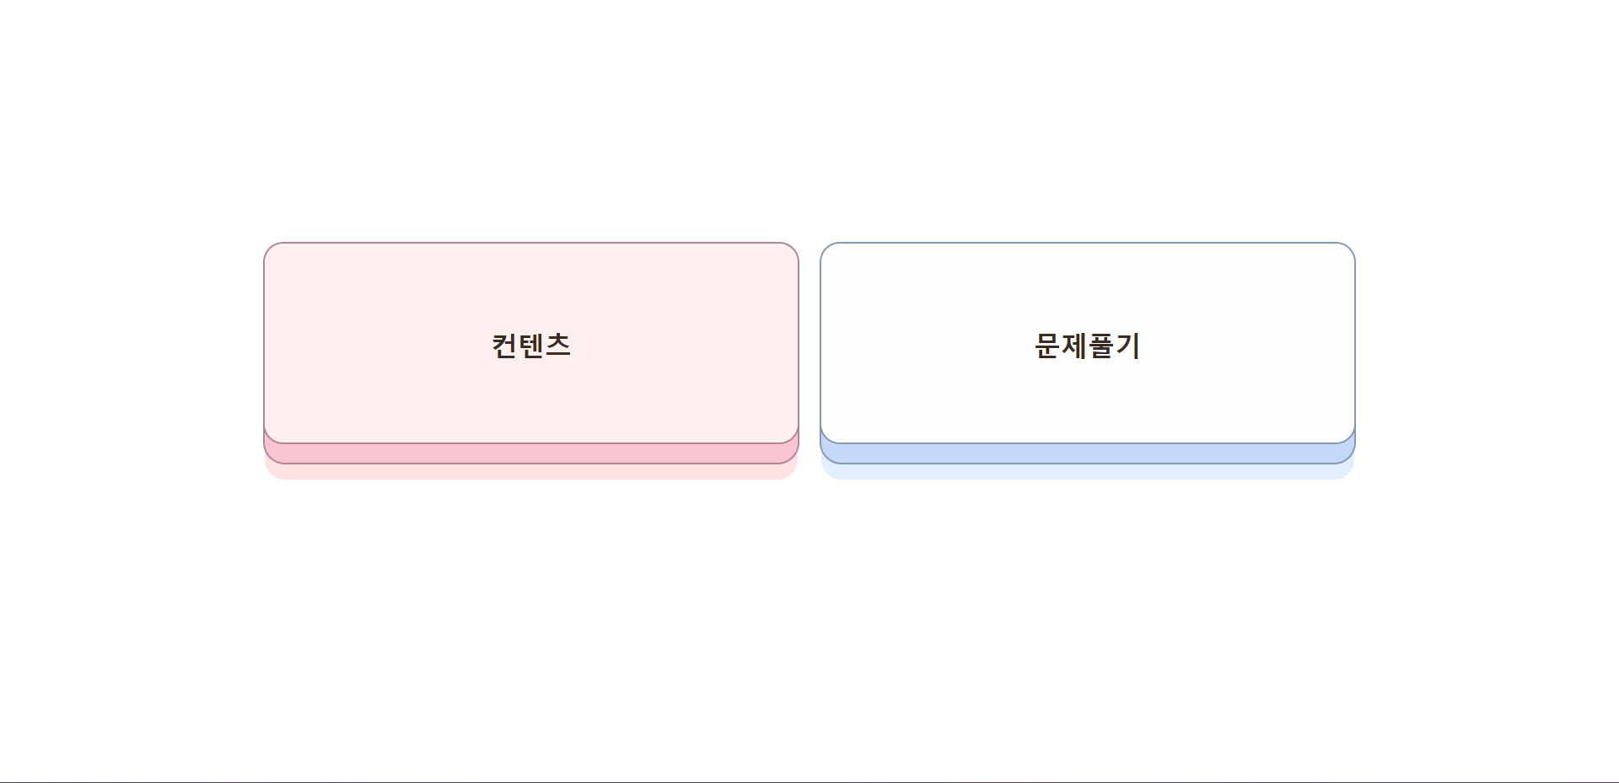

Slide 13
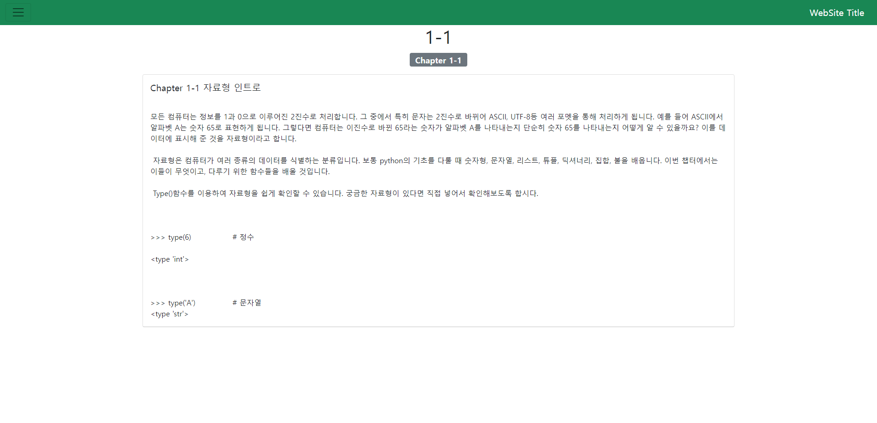

Slide 14
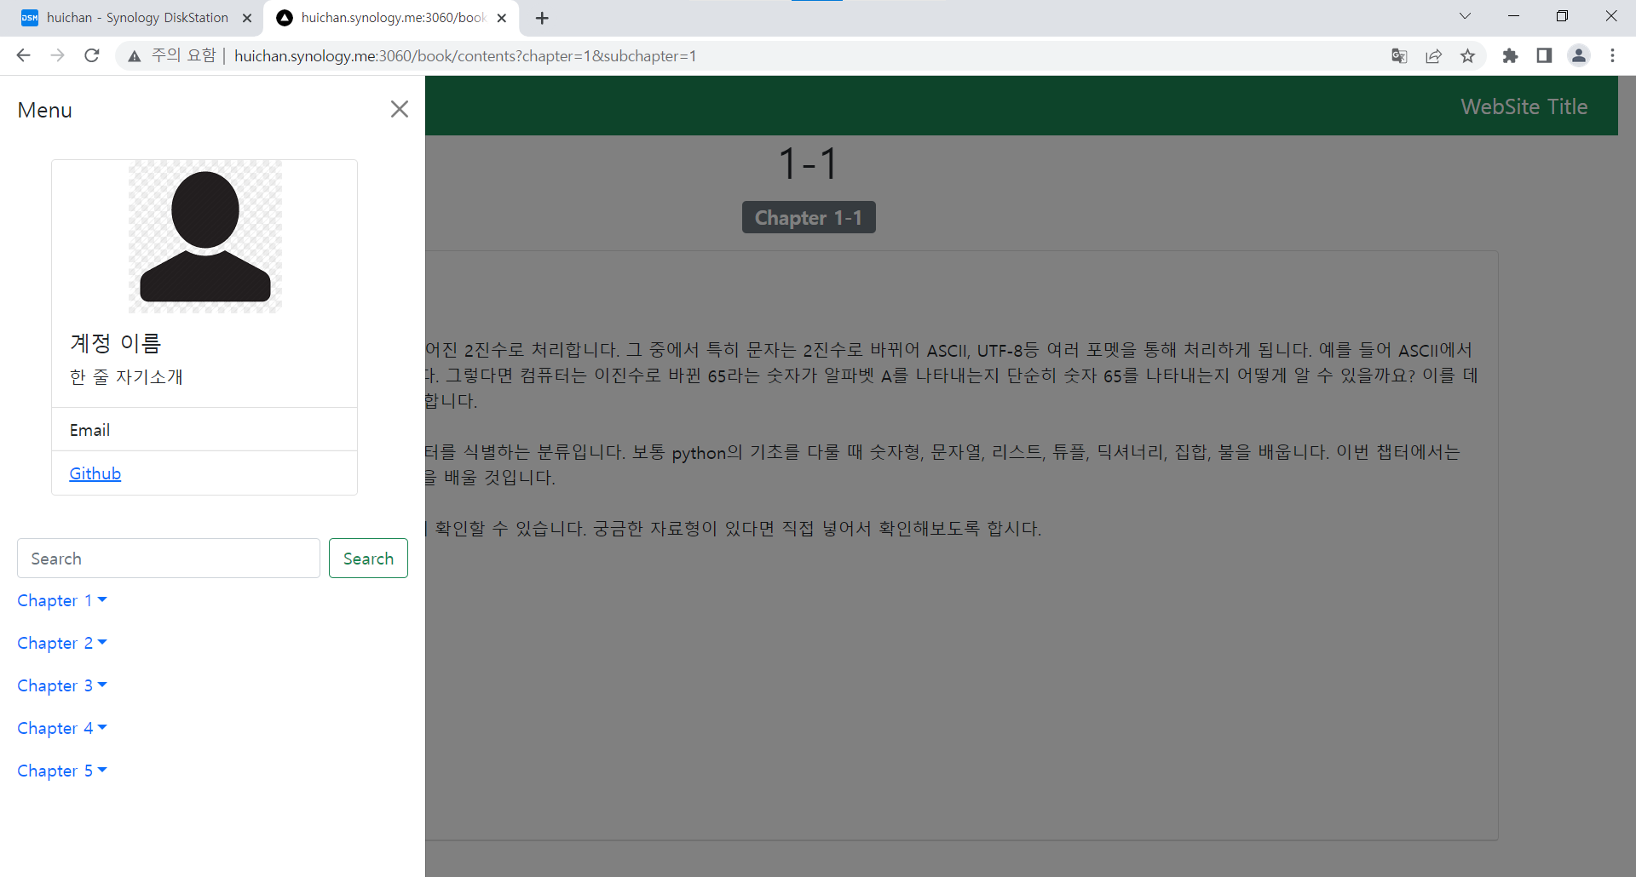

Slide 15
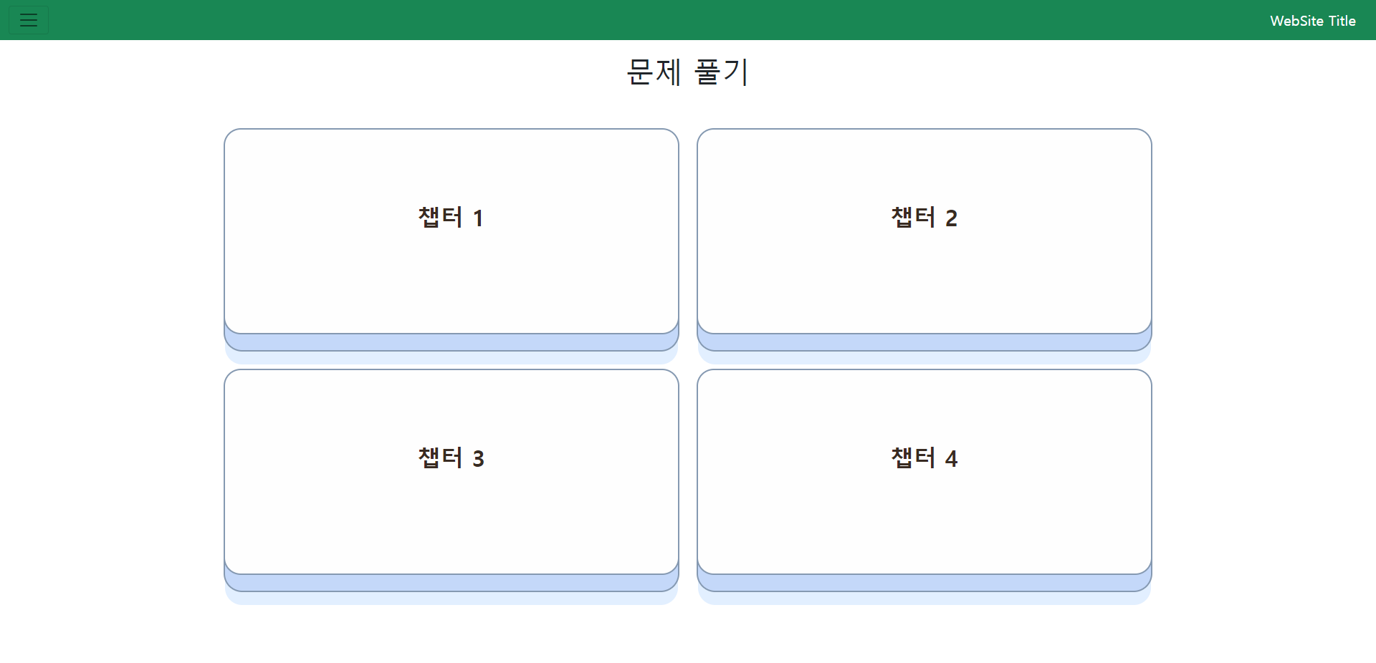

Slide 16
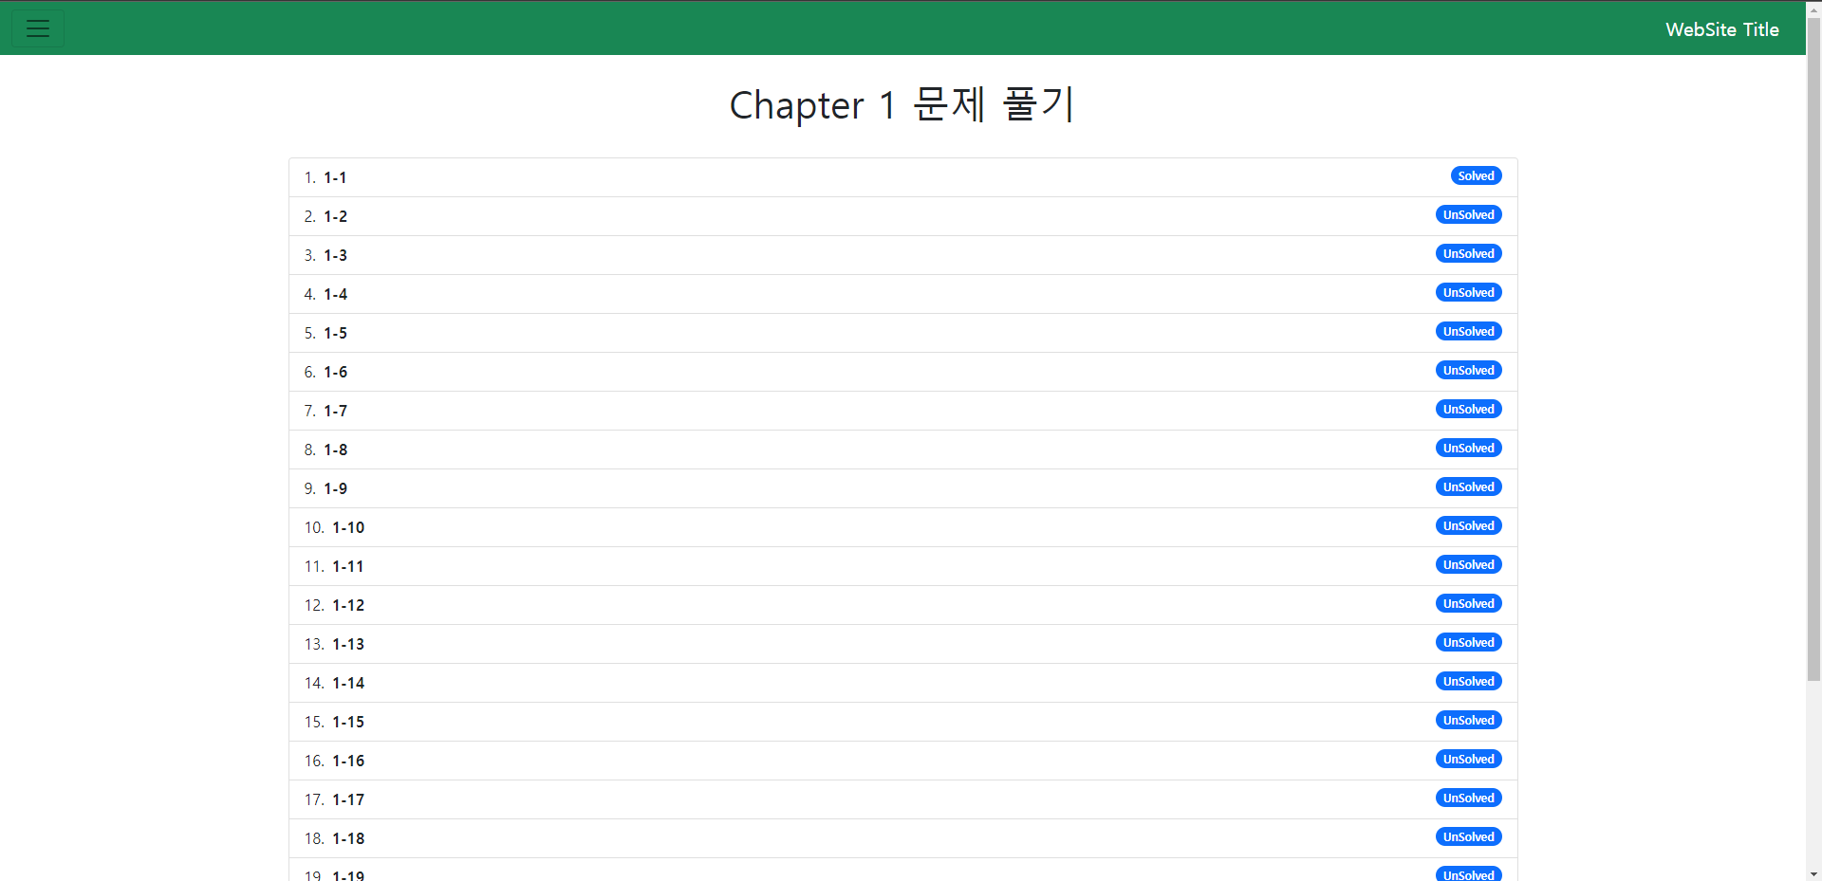

Slide 17
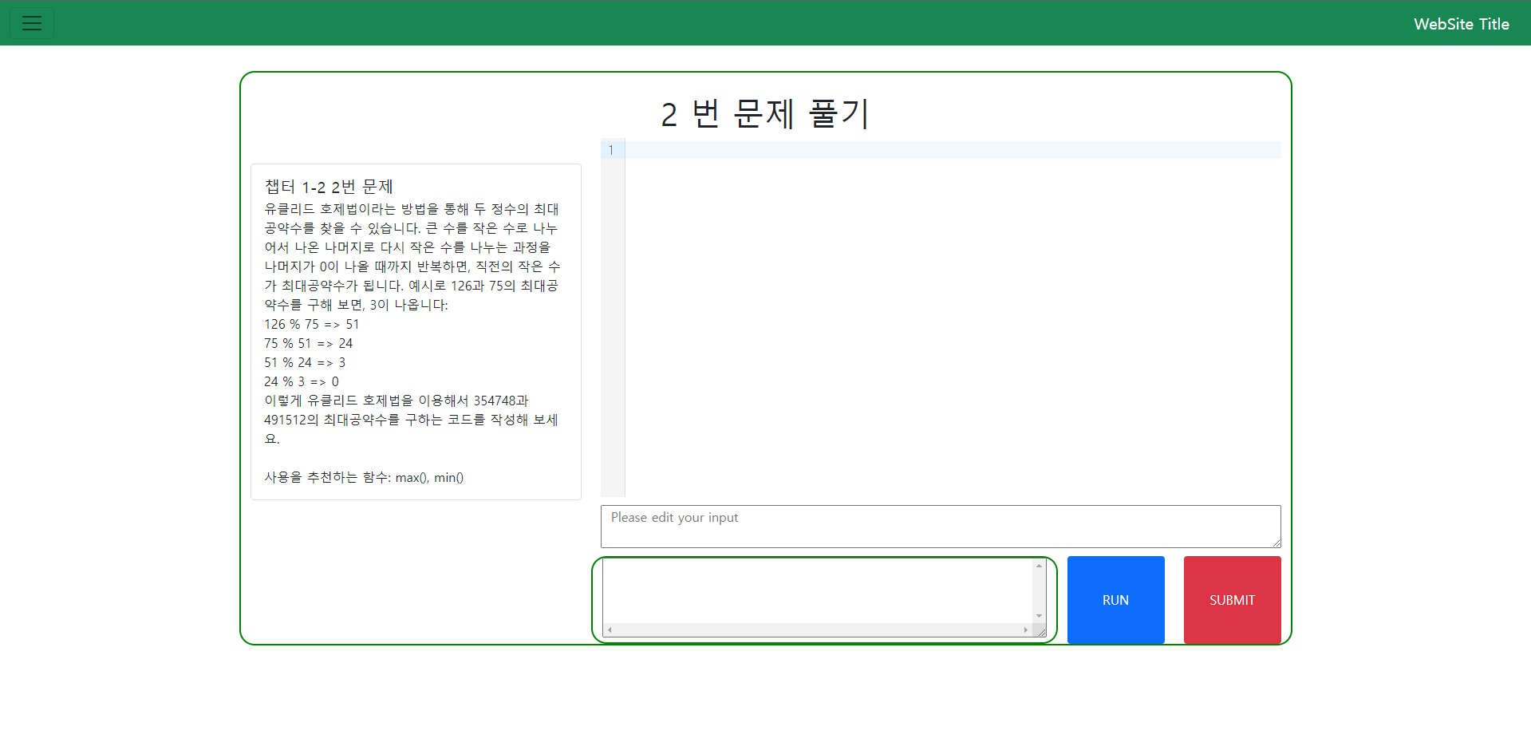

Slide 18
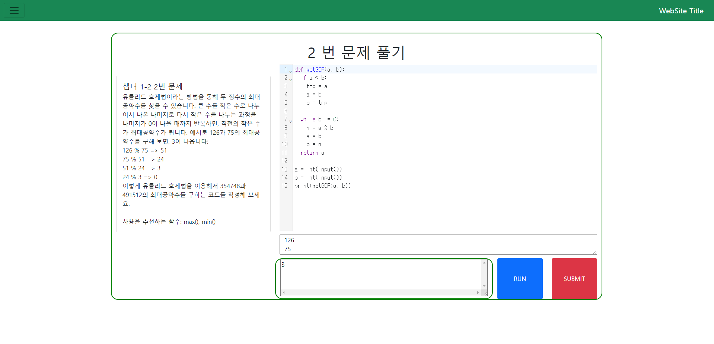

Slide 19
Container deployment
Dependency and Docker containers maintained by two shell scripts run.sh and stop.sh
node:18, mysql:8, and python:3.10 container executed by docker
Python container is volatile alive, when code should be executed
Nodejs
Container
Mysql
Container
Python3
Container
(volatility)

Slide 20
server Environment
Deployed and tested on a personal NAS-Synology

